Slide 1
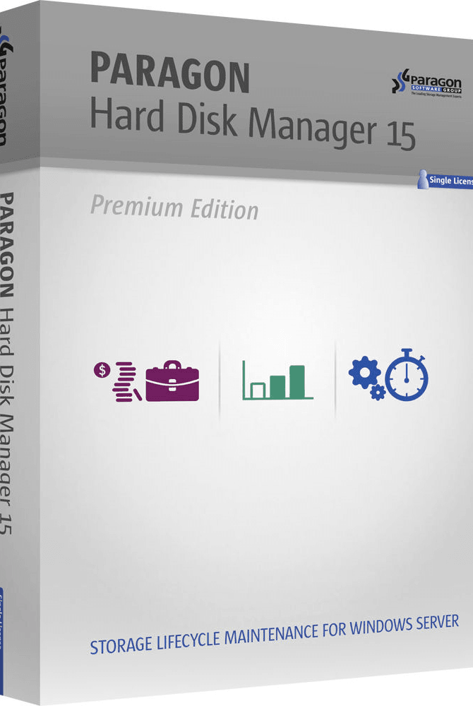

Using Paragon to clone a disk partition on our PC
Here is where your presentation begins

Slide 2

How to clone disks with Paragon?
Paragon Hard Disk Manager (HDM) is a data security and storage management product developed by Paragon Software Group. It is a complete, all-in-one data management solution for Windows PC users working in physical or virtual environments. You can use its HDM 15 Suite to:

Slide 3
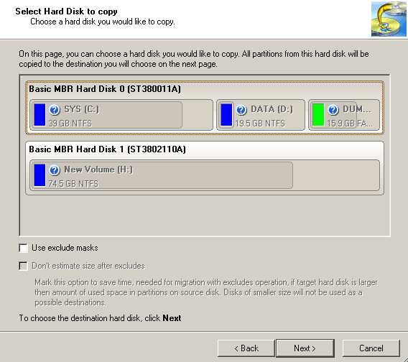

How to Perform Paragon Disk Copy Step by Step
Paragon Hard Disk Manager provides you with more features than mentioned above. With HDM 15 Suite, you can copy a disk through its Drive Copy feature. It is available in the Paragon Drive Copy Professional. This tool provides the means to copy a whole hard disk or just a partition and also to migrate the operating system, programs and data to another HDD or SSD.
Connect a new disk to the computer. Launch Hard Disk Manager.
Click the Copy & Migration tab on the Ribbon Panel, then select Copy Hard Disk.
Select a hard disk you want to copy.

Slide 4
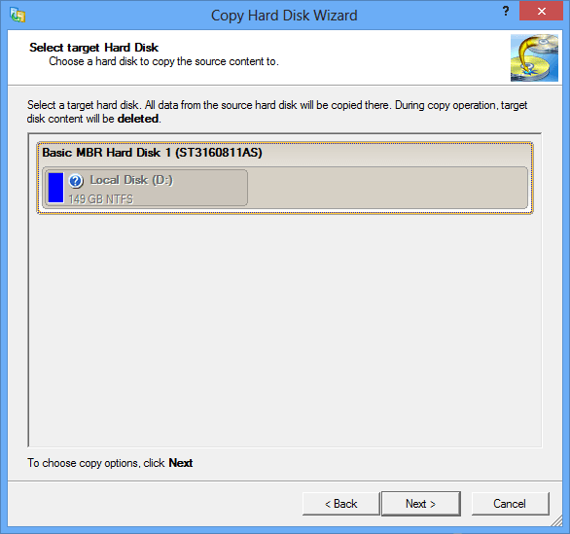

How to Perform Paragon Disk Copy Step by Step
Step 4:
Select a hard disk (if several) where all data of the source disk will be copied to.

Slide 5
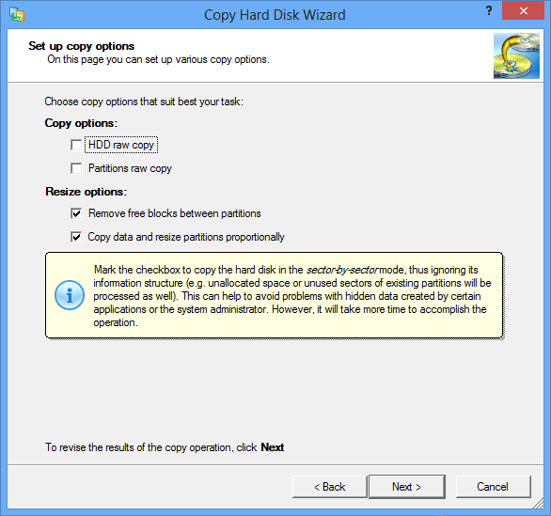

How to Perform Paragon Disk Copy Step by Step
Step 5:
Then you can set up copy options. And then click Next.

Slide 6

The Best Alternative to Paragon Clone Disks
As a cloning software, Paragon Hard Disk Manager may meet your needs when you want to copy disks or migrate OS. But the Paragon Hard Disk Manager 15 Suite has some limitations:
Other Tools to clones
Acronis Cyber Protect Home Office. 17 reviews. ...
Symantec Ghost Solution Suite. 4 reviews. ...
Macrium Reflect. 3 reviews. ...
EaseUS Todo Backup. 3 reviews. ...
MiniTool Partition Wizard. 1 review. ...
Clonezilla. 1 review. ...
Drive Copy Professional. 0 reviews. ...
Acronis Disk Director. 0 reviews.

Slide 7

Thanks!
Do you have any questions?
jack@ip.new
Jackmwisa.com

